Slide 1



Unlocking potential with Parent-Child Interaction Therapy

Slide 2


Who we are?
Add your own photos
—->
-Add Speaker, Agency, Credentials and Experience

Slide 3

Our Time Today
Welcome & Introductions
Describe the PCIT Program & Concept to Interested Agencies
Introduce Key PCIT Concepts and Skills
How does PCIT fit at Your Agency? Ideal/Possible
Questions and Discussion

Slide 4


Parent-Child Interaction Therapy Unlocking Potential for Families

Slide 5
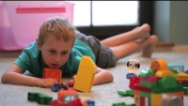

Slide 6








PCIT is Recognized as an Evidence-Based Treatment and Best Practice

Slide 7



Slide 8


What is PCIT?
Children ages 2.5 to 7 years with disruptive/externalizing behaviors
Caregivers with history of harsh parenting
Work with the primary caregiver/parent (birth, kin, foster, adoptive) and child together

Slide 9


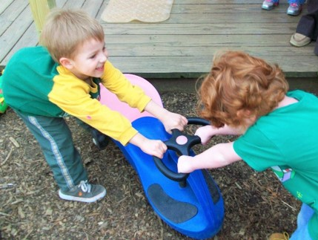
PCIT IS DURABLE
Built to address early onset Conduct Problems
Appropriate for children showing:
Verbal or physical aggression
Defiance
Noncompliance
Temper Tantrums
Hyperactivity
Parents with harsh or overly punitive parenting
Parents who could benefit from enhanced relationship or behavior management skills with young children

Slide 10


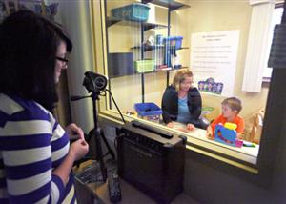
PCIT is unique to families
In-the-moment Coaching
Parent and child together
Focus on interaction patterns
Assessment driven

Slide 11



Goals of Treatment
Promote
a warm, nurturing caregiver-child relationship
Increase
child’s prosocial behaviors while decreasing challenging behaviors
Create
an enduring change in both parent and child behavior

Slide 12

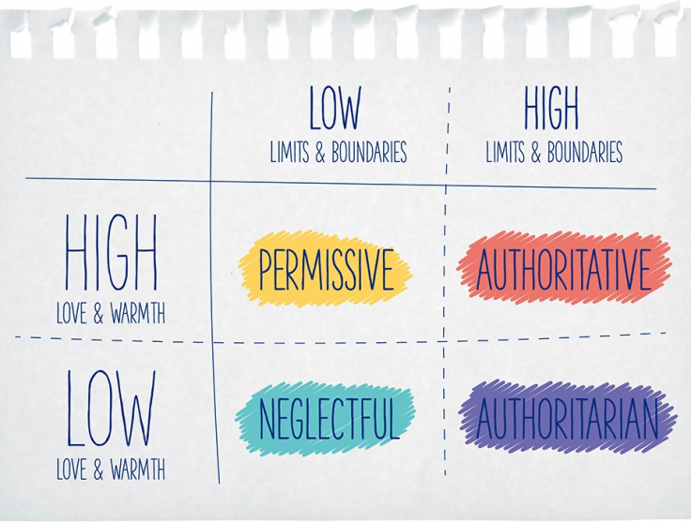
PCIT teaches skills to nurture child growth

Slide 13

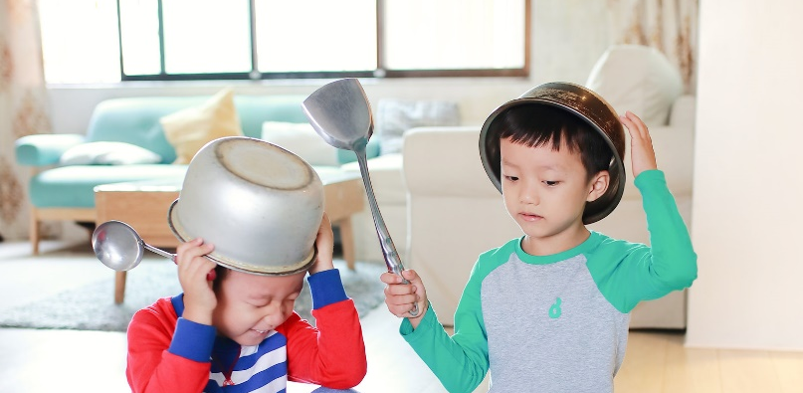
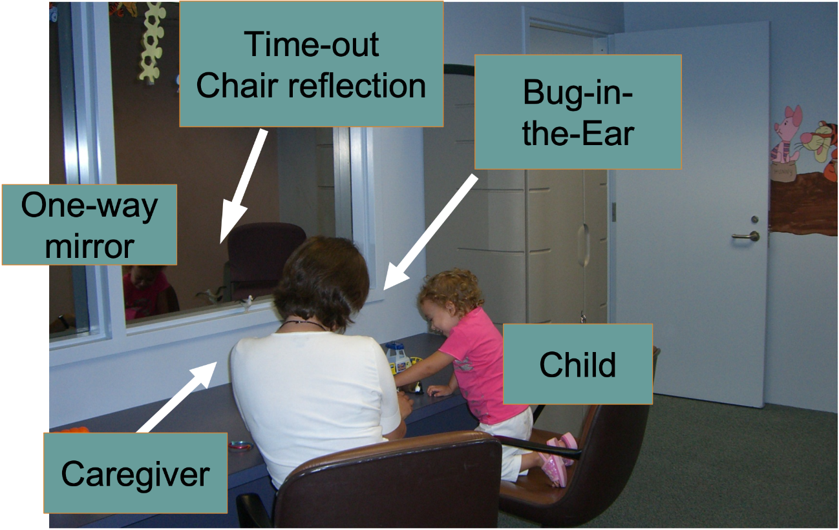


PCIT Brings the Parent into Parent-Child Play

Slide 14
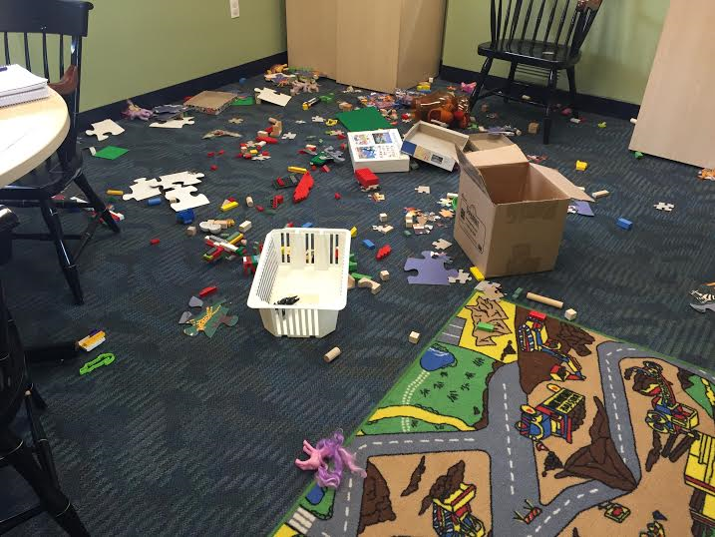

Calming the Storm with the Core Structure of PCIT
1
2
Discipline Phase: Parent leads child
Clear communication
Consistency
Reasoning skills
Child-Directed
Interaction
Parent-Directed
Interaction
Attachment-Foundation Phase: Parent follows child’s lead
Play therapy skills
Positive attention skills
Differential attention

Slide 15

Progression of PCIT
Pre-Assessment
PDI Teaching session
Includes generalization of skills to home and public settings
CDI Teaching session
Explain, Model, Role-play
Explain, Model, Role-play
PDI Coaching sessions (10-20)
CDI Coaching sessions (3-8)
Includes specific skill training and homework
Post-Assessment

Slide 16

Child Outcomes
Increase in compliance
Child disruptive behavior improves from clinical range to within normal limits

Slide 17



Parent Outcomes
Strong PCIT skill acquisition
More positive attitudes towards child
High parent satisfaction
Improvements in self-reports of maternal depression and parental stress

Slide 18

PCIT Reduces Re-abuse Rates
6 RCT Studies involving physically abusive parents (e.g., Chaffin et al., 2004; Kennedy et al., 2014)
Reductions in Physical Abuse and Child-specific Parenting Stress
After 2 years (850 days), 30% difference in re-abuse rates
Typical community parenting group: 49%
PCIT parents: 19%
Completers vs. dropout study 30% difference
PCIT Dropouts: 73% re-reports
PCIT Completers: 43% re-reports

Slide 19





PCIT SENSITIVE TO DIVERSE FAMILY NEEDS
Effectiveness with
Trauma victims/survivors
Children with prenatal alcohol/substance exposure
Children aged 18-60 months with premature births and externalizing behaviors
Children with developmental delays and/or mental retardation
Older children (above 7 years)
Younger children (below 2 years)
Foster parents and maltreated children
African-American families
Latino and Spanish-speaking families
Native American families
…

Slide 20

Enduring Change
Treatment gains have been maintained for one to six years
Treatment gains generalize to:
Untreated siblings
Child school behavior

Slide 21



An Introduction to the PRIDE Skills

Slide 22


Rolling out the PRIDE Skills in PCIT The CDI Teach Session
One-hour session
Parents alone
Didactic presentation of skills
Definition
Rationale
Examples
Modeling / demonstration
Role-play with parents
Notes:
Add stock photo

Slide 23
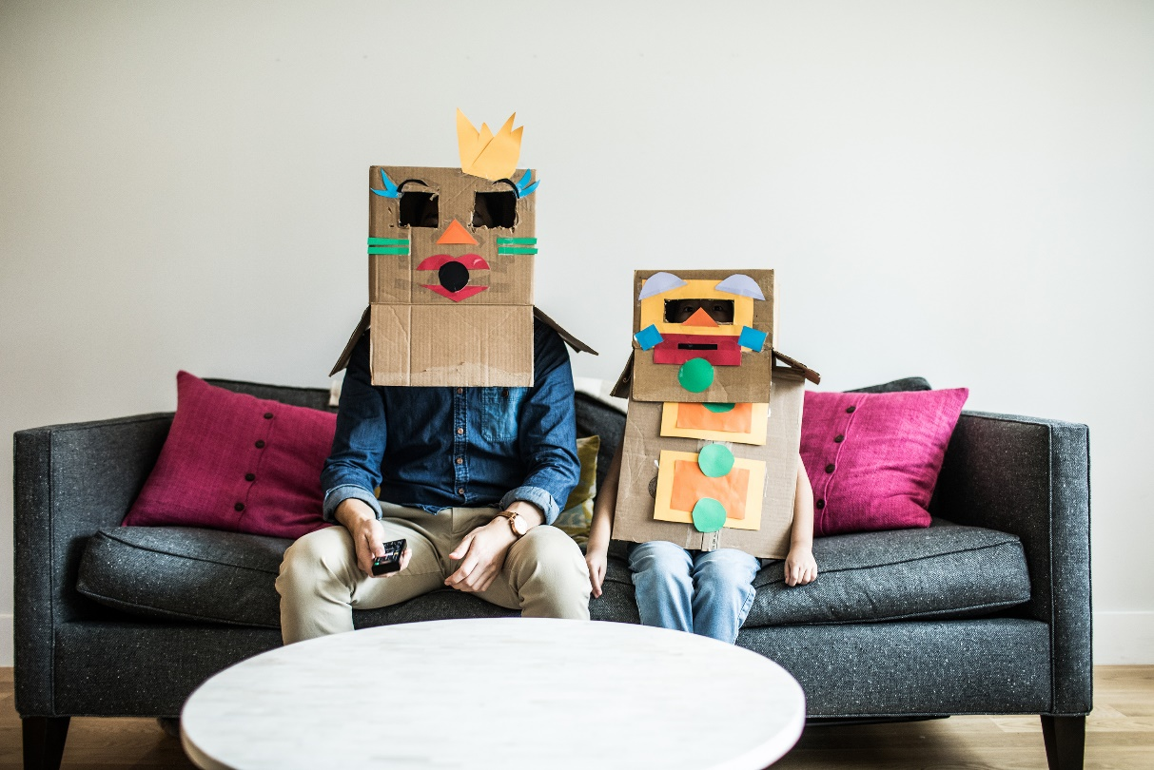
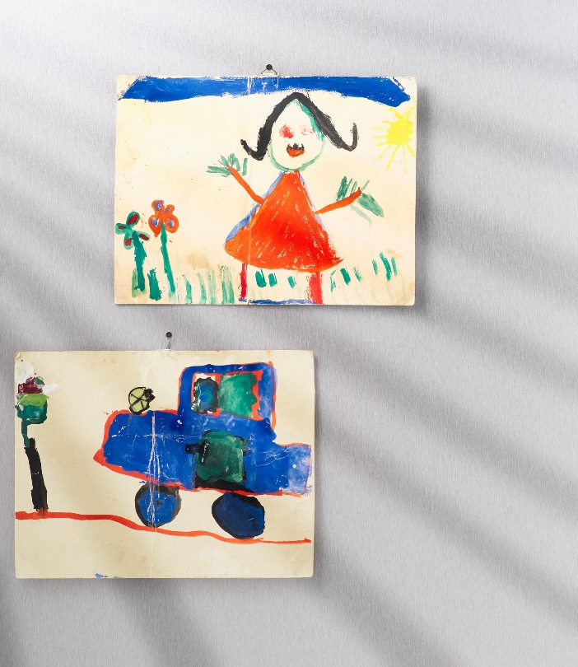
The Basic Rule of CDI
Follow the Child’s Lead

Slide 24
Why follow the child’s behavior?
CDI is relationship enhancement phase
Following lets parent view child in new way
Parent learns to use positive attention skills
Child begins to enjoy parent-child interaction
Parent learns to use differential social attention
New child behaviors reinforce the parent’s positive behaviors
Notes:
*This slide is really about providing a rationale for CDI – it isn’t really something we tell parents directly in CDI teach
Children begin to enjoy parent-child interaction: Positive attention becomes powerful positive reinforcer
Parent learns to use differential social attention-Parents learn to shape new child behavior

Slide 25



CDI “AVOID” Skills
COMMANDS
QUESTIONS
NEGATIVE TALK/ CRITICISM

Slide 26


The CDI DO Skills: PRIDE
PRAISE
REFLECT
IMITATE
DESCRIBE
ENJOY

Slide 27
Setting Limits in Early Childhood

Slide 28
Parent-Directed Interaction (PDI)
Notes:
What are times that parents need children to listen?

Slide 29


Authoritative Parenting
Limit
Setting
Most therapeutic parenting style
Interventions often fail to address limit setting
PCIT goes a step further by teaching a parent how to be both nurture and set limits
Nurturance
Control
Warmth

Slide 30

Effective discipline
Teach caregiver to effectively discipline a child not responding to typical discipline techniques
Scientifically proven approach
Behavior within normal limits after 7 weeks of training
Notes:
Uses modeling, role-playing, & homework

Slide 31



Focus of PDI
CONSISTENCY
PREDICTABILITY
FOLLOW-THROUGH

Slide 32
How many times do referred children misbehave on a typical Saturday?
Children misbehave over 100 times in a typical day

Slide 33
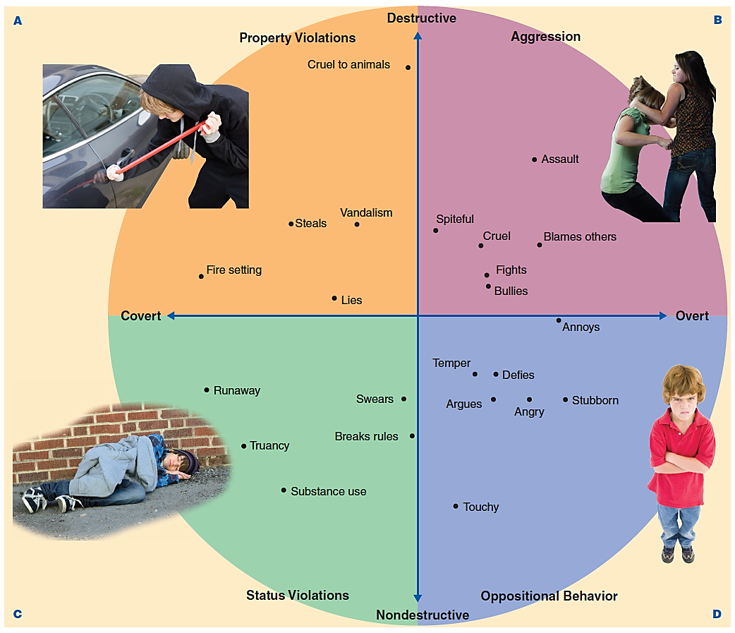
The Core Issue
Noncompliance
Source Adapted from “Oppositional Defiant Disorder and Conduct Disorder A Meata-Analytic Review of Factor Analyses and Cross-Validation in a Clinic Sample,” by P. J. Frick, Y. Van Horn, B. B. Lahey, M.3A. G. Christ, R. Loeber, E. A. Hart, L. Tannenbaum & K. Hanson, Clinical Psychology Review, 13, 319–340. Copyright © 1993 Elsevier Science, Ltd. Reprinted with permission from Elsevier Science. Photo Credits (a) © 2011 Paul Bradbury/Jupiterimages Corporation, (b) © 2011 Weston Colton/Jupiterimages Corporation, (c) © iStockphoto.com/Patrick Herrera, (d) © Monkey Business Images/Dreamstime.com

Slide 34
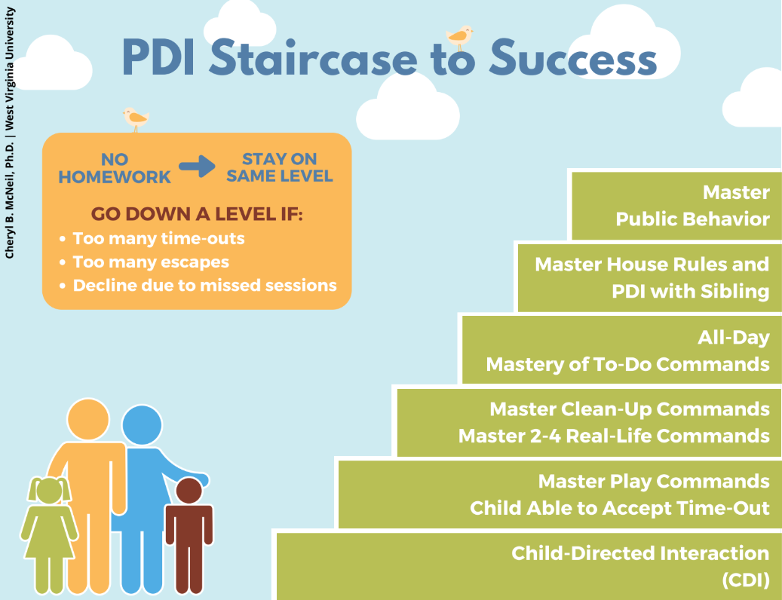
Gradual Introduction

Slide 35

Questions & Comments
Please contact: Add Email
Add Phone

